Slide 1
Technological Progress & Natural Gas Resource Depletion
Past Experience & Prognostications of the Future
Pulak K. Ray
Chief Geologist,
Minerals Management Service

Slide 2
Present Situation
Increased costs per unit and risk on the shelf due to:
  Smaller size field discoveries
  Increased production decline rates
Reduced exploration costs and risks especially in deepwater due to:
  Higher success rates
  Less field delineation costs

Slide 3
Technology Drivers (NPC ’99)
New Field Exploration Efficiency
  By 2015 1.1% to 4.0%
Platform Cost Reduction
  0.75% - 4%
Drilling & Completion Costs
  Shallow water 1.25% - 3.5% Deep Water
Ultimate Recovery per Well
  0.5% to 2.5%

Slide 4
Expected Areas of Technological Improvements:
    Exploration Efficiency
      4D Seismic, 3D Shear wave (for infield development), Deep wireline measurements etc.
    Cost Reduction
      Knowledge management, integrated well planning, improvement/innovation in drilling technology, expendable tubulars, subsea processing, free standinf drilling risers etc.
    Recovery Efficiency
      Stimulation

Slide 5
Evaluating Technological Impact
Historical Trends in Natural Gas Production in the Gulf of Mexico
  Reserves Addition from:
    New field discovery
    Reserves Appreciation/Growth
  Completions & Production/Decline Rates
Future Prognostications

Slide 6
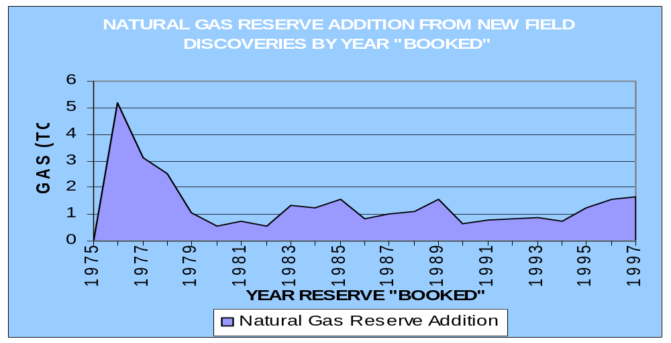

Slide 7
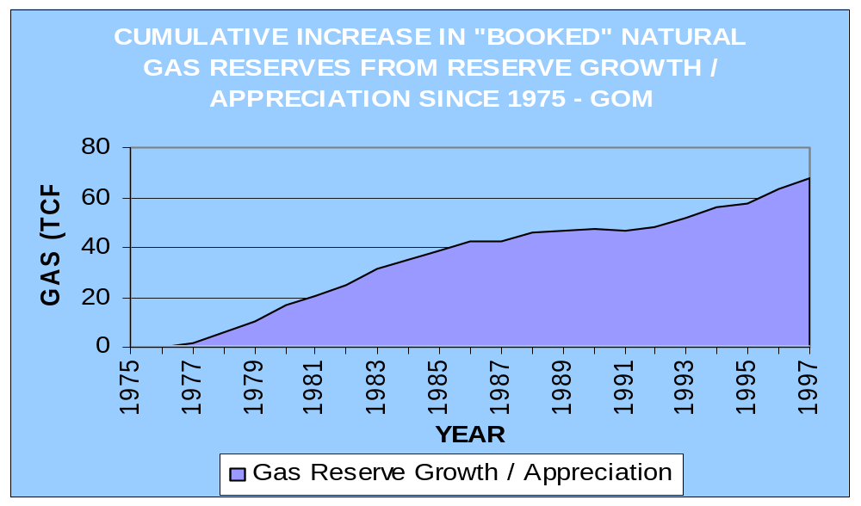

Slide 8
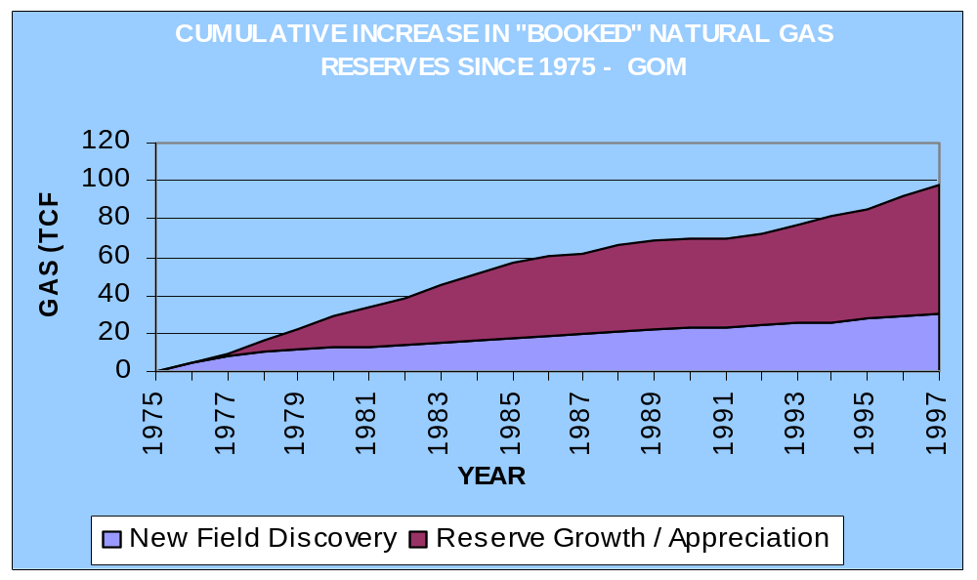

Slide 9
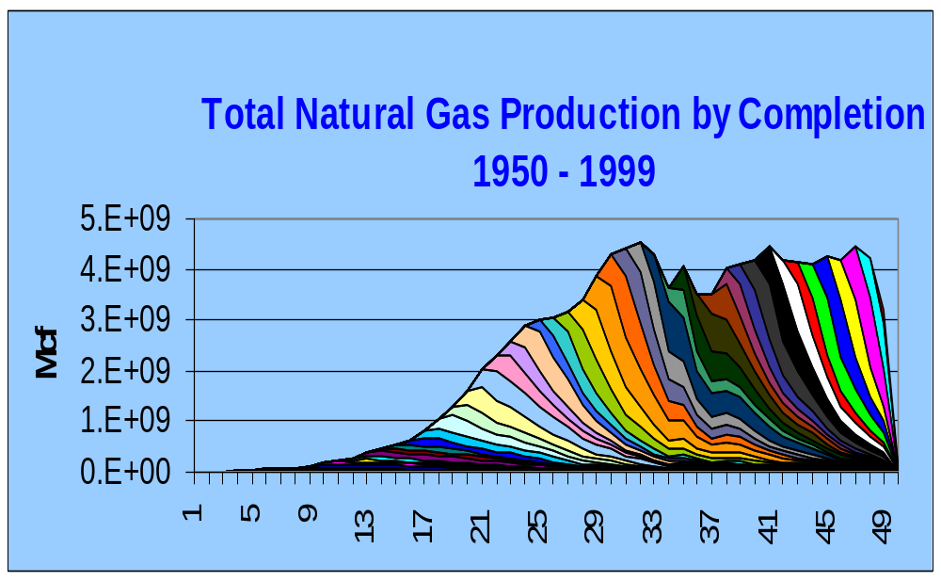

Slide 10
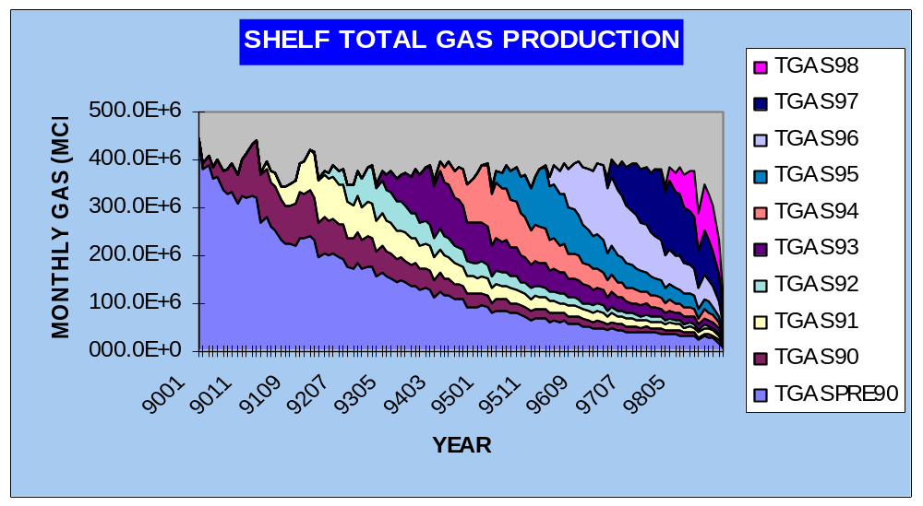

Slide 11
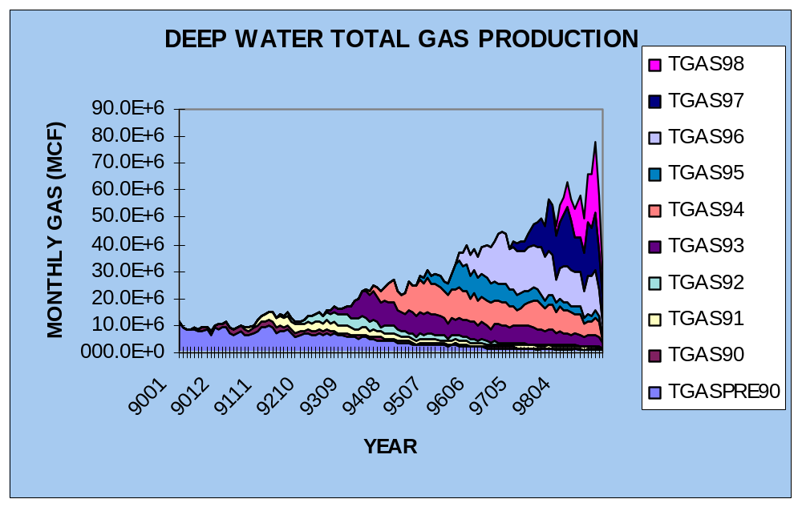

Slide 12
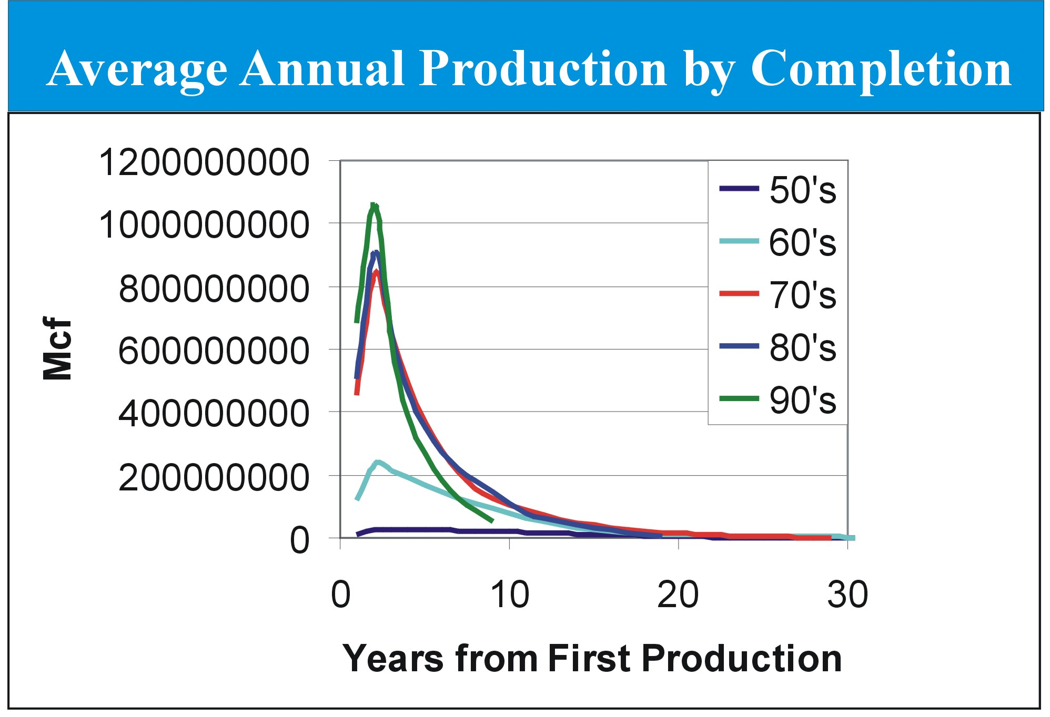

Slide 13
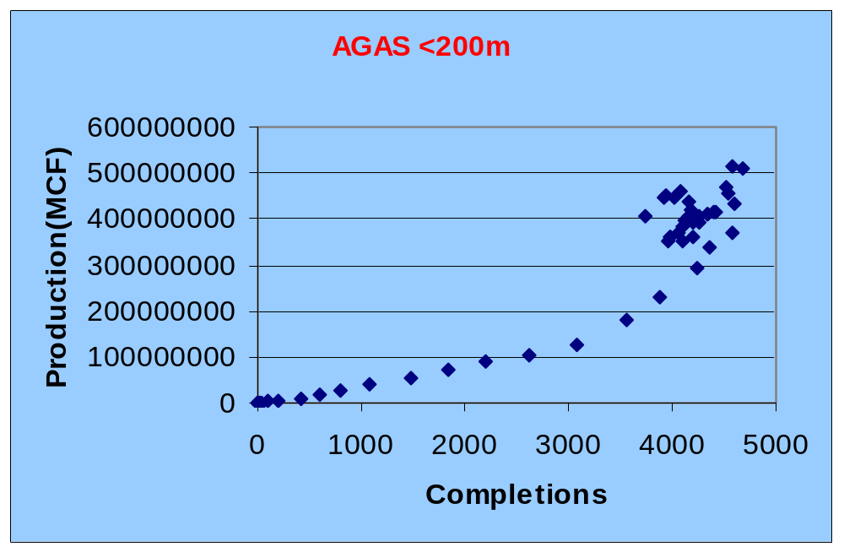

Slide 14
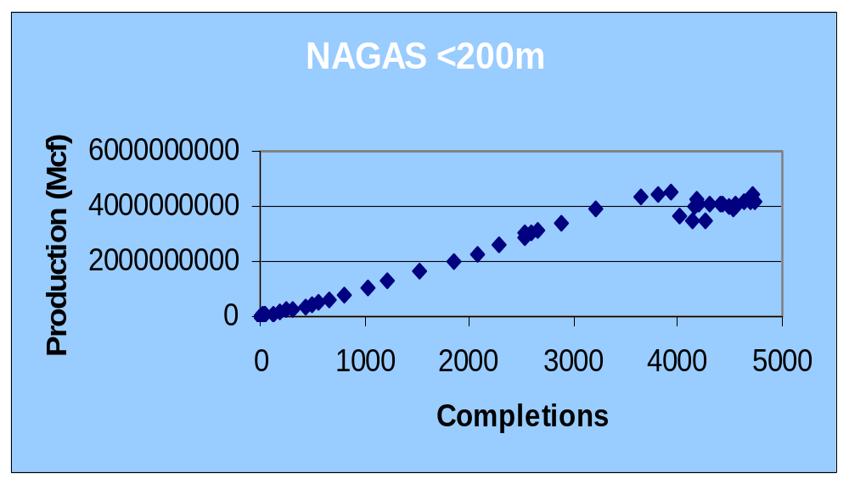

Slide 15
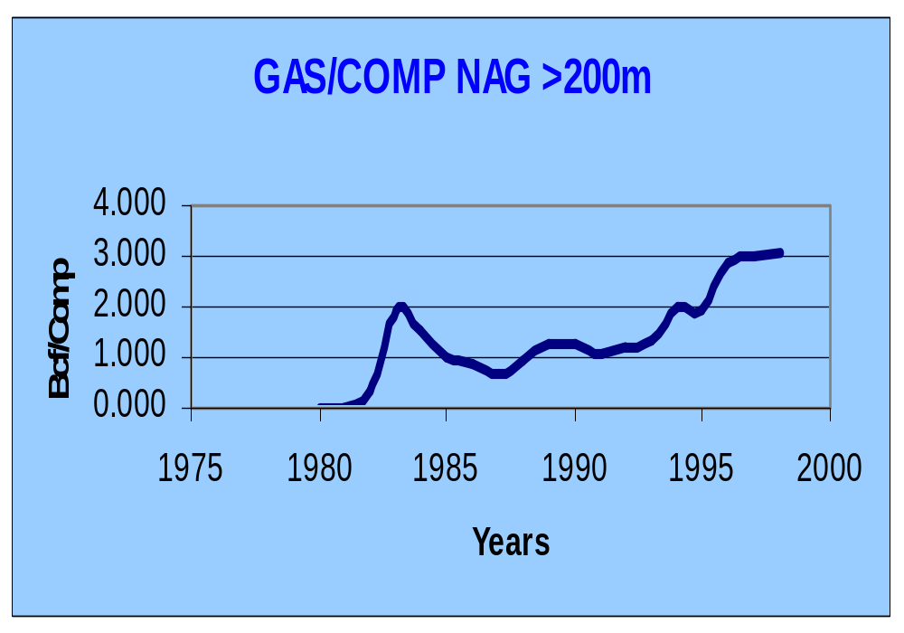

Slide 16
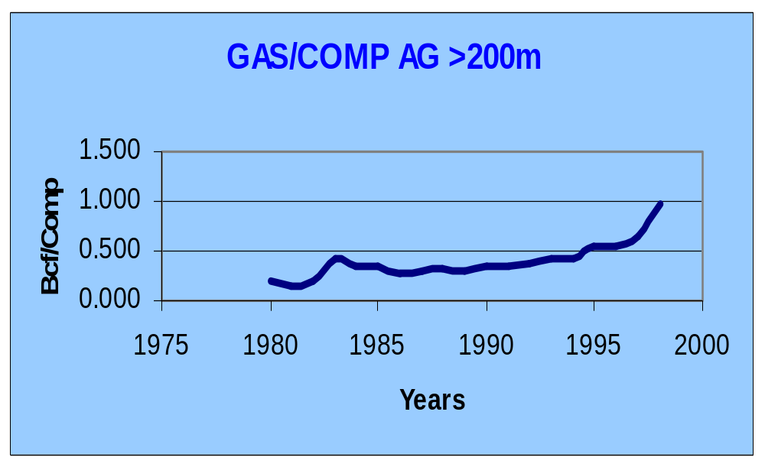

Slide 17
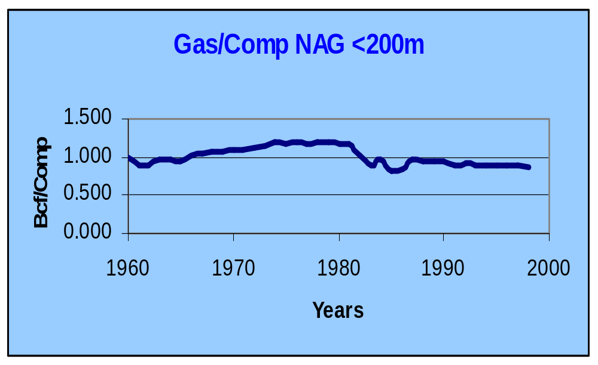

Slide 18
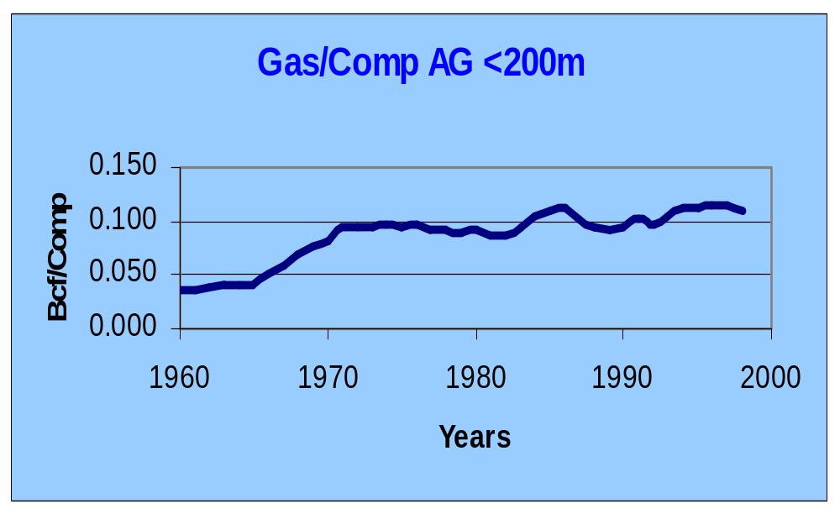

Slide 19
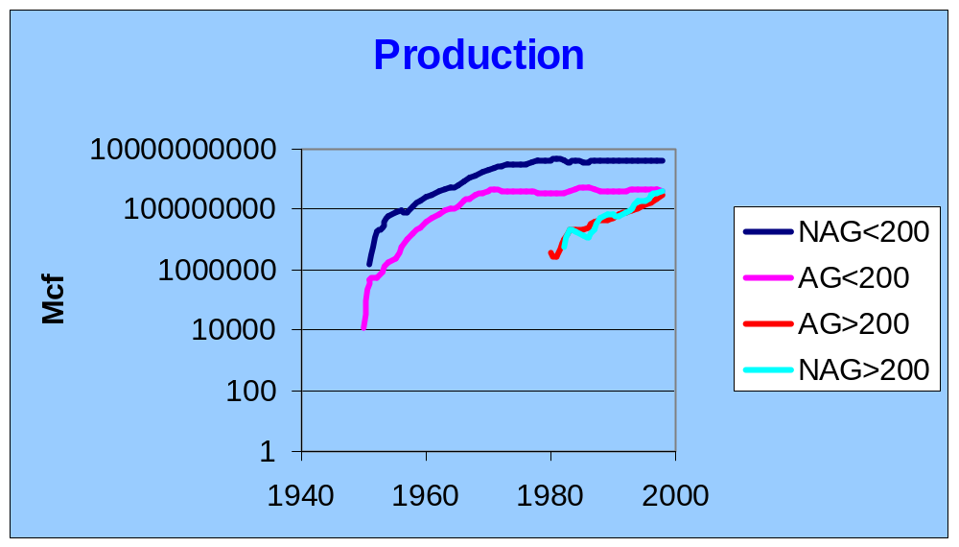

Slide 20
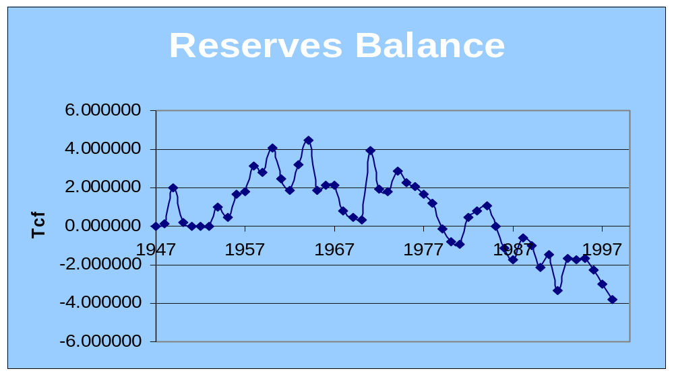

Slide 21
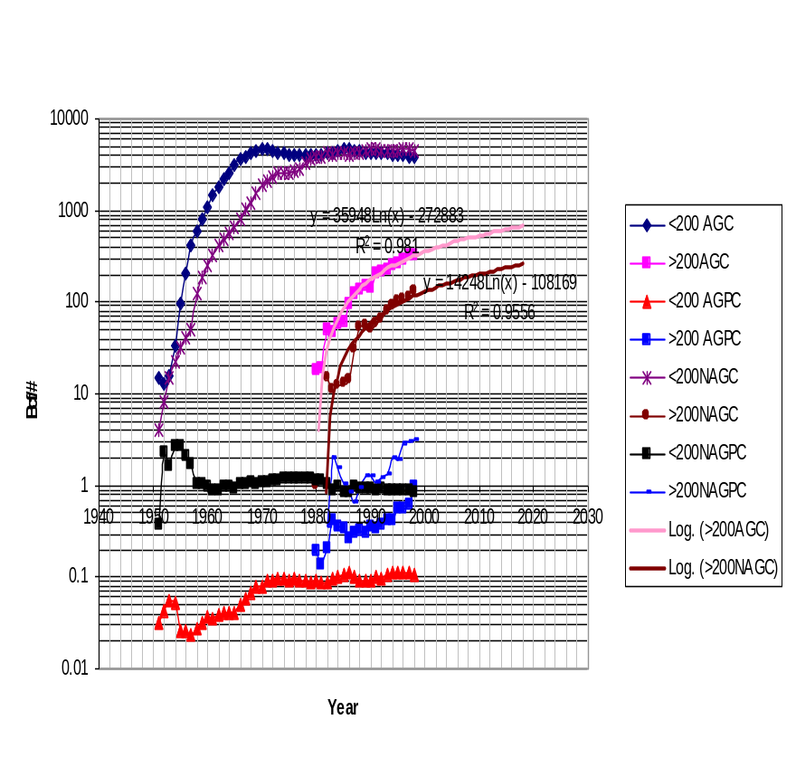
What is the future?
Increased deepwater discovery and completions
Increased deep shelf exploration & development
Access to areas with resources
Unimpeded implementation of new technology

